Slide 1

INTERNATIONAL ONLINE HACKATHON - AI to GLOW
(Artificial Intelligence to Generate Limitless Opportunities Worldwide)
G
L
O
W
@
V
I
T
B
Team No: GLOW100
Domain Name : Artificial Intelligence
Title : "EduConnect: Bridging the Learning Gap with AI"
Prassanna Laxmi
24MSP3078
First Year

Slide 2
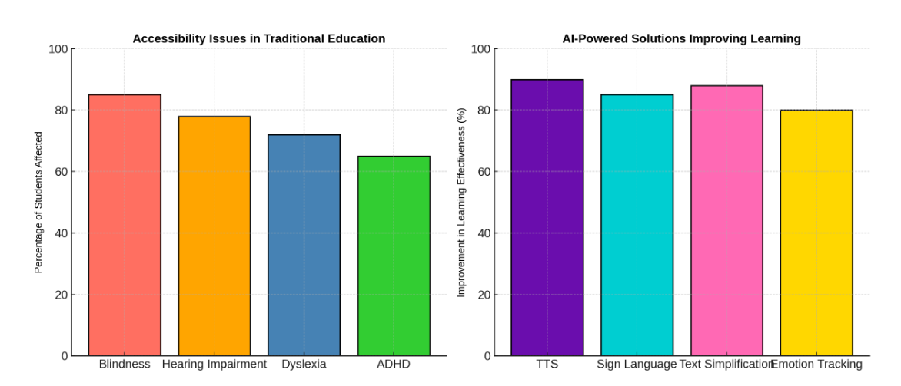
TITLE : "EduConnect: Bridging the Learning Gap with AI"
Problem Statement :
Millions of students with disabilities face challenges in traditional education due to a lack of accessibility. Blind students struggle without Braille or text-to-speech support, hearing-impaired students miss out on lectures without sign language translation, dyslexic students find reading difficult, and ADHD learners face engagement issues. Existing learning systems do not adapt to individual needs, making education inaccessible for many. Our AI-Powered Inclusive Learning Hub aims to bridge this gap by providing an adaptive and inclusive learning experience for all students.

Slide 3
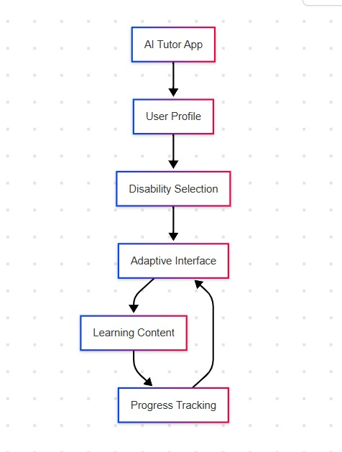
Methodology

Slide 4
Methodology
AI Tutor App (A) – An AI-powered learning platform that adapts to user needs.
User Profile (B) – Collects basic details like name, age, and learning preferences.
Disability Selection (C) – Allows users to specify disabilities (e.g., visual, hearing, cognitive).
Adaptive Interface (D) – Customizes the interface based on user needs (e.g., text-to-speech, sign language, larger fonts).
Learning Content (E) – Provides personalized educational materials based on the user’s learning style and disability.
Progress Tracking (F) – Monitors user performance, provides feedback, and adapts content accordingly.

Slide 5
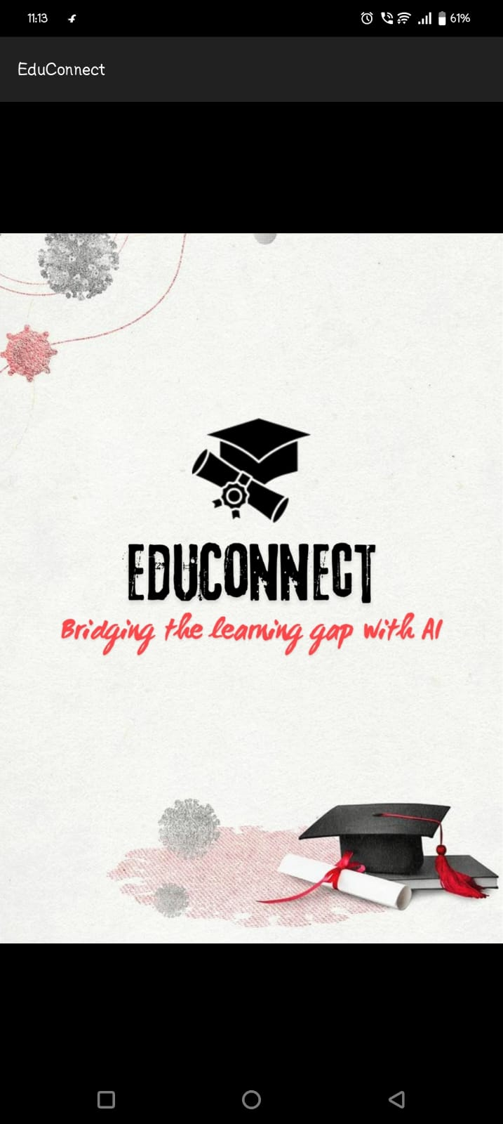
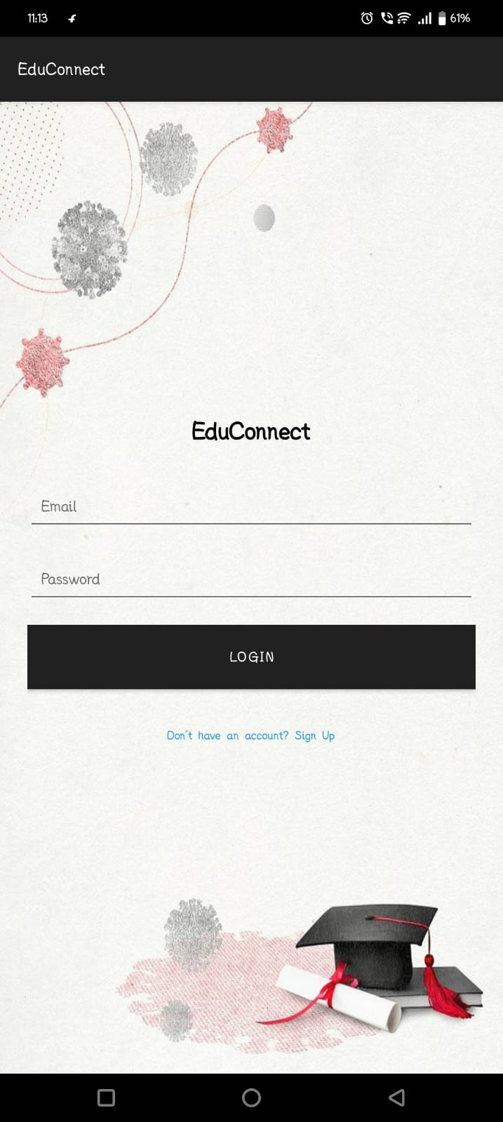
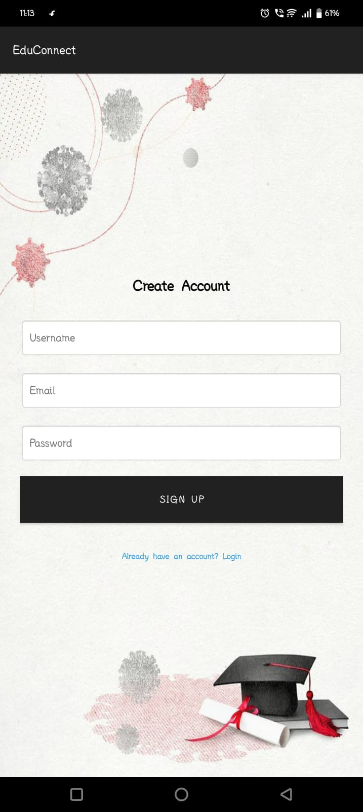
Results/Screenshots

Slide 6
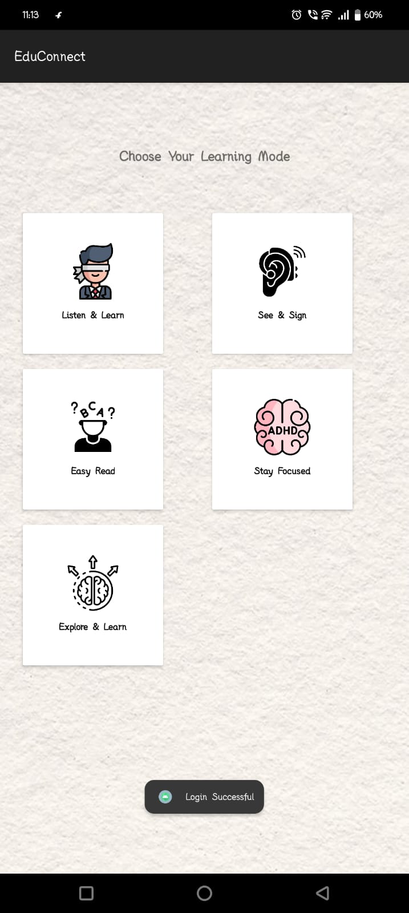
Results/Screenshots

Slide 7
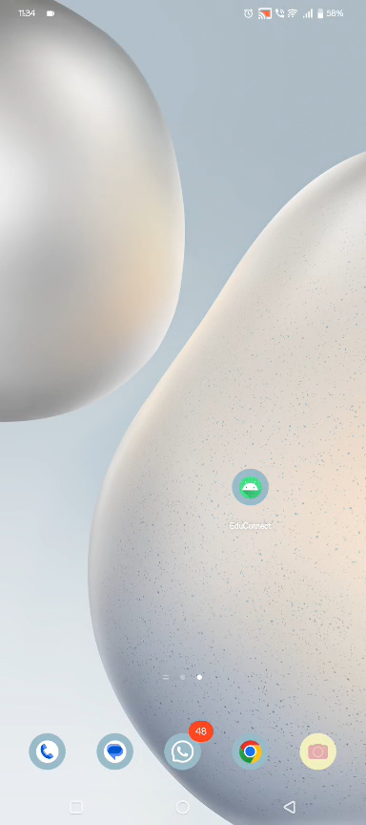
Results/Screenshots/Live Demo

Slide 8
Outcome
Personalized Learning: Adapts content to individual needs, ensuring better understanding.
Text Simplification: Converts complex text into easy-to-read language for accessibility.
Speech-to-Text : Real-time translation for hearing-impaired students.
Gamified Learning: Interactive quizzes and rewards to boost engagement.
Text-to-Speech: Enables visually impaired students to access content effortlessly.
Android Application: Provides a user-friendly platform for students to access personalized learning, text simplification, sign language translation, and gamified education anytime, anywhere.

Slide 9
Conclusion
The AI-Powered Inclusive Learning Hub addresses accessibility challenges for students with disabilities.
It provides personalized learning and text simplification to cater to individual needs.
Speech-to-sign language translation supports hearing-impaired students in real-time.
Gamified learning enhances engagement and motivation.
Text-to-speech enables visually impaired students to easily access content.
The Android app offers a user-friendly platform for accessible, adaptive, and engaging education anytime, anywhere.

Slide 10
